Slide 1
Project 3 Team: 01 - 800 NEED CASH NOW January 2022
Georgia Tech | Analytics Boot camp

Slide 2


Team Members
Joby Augustine Ryan Hulett Karla Robles

Slide 3
Motivation
Data sets such as crime rate and unemployment are very valuable tools for making decisions in many different areas
Quality of Life:
Deciding what city to move in
What city would you want to raise your family
Employment
When evaluating different job offers that require relocation
Investment
When buying a house
When investing in commercial or vacation real estate
1
2
3

Slide 4



Analytics Solution
To solve these and many other questions, our team put together a dashboard that helps the user visualize this data in a very easy way.
To achieve this, the team used the following tools in python:
Pandas
NumPy
Matplotlib

Slide 5





Additional Tools
HTML
CSS
JS Library
Mongo DB (SQL)
Flask
Leaflet JS library

Slide 6

How does it work?
The dashboard compares the unemployment rates with different crime rates across the United States by year.
Users will be able to select their crime and necessary add-ons which will automatically update the map as we progress.
The users will also be able to select a certain state from which the database will return the top 10 cities for crime within the chosen state.
Source:
https://www.kaggle.com/axeltorbenson/unemployment-data-19482021
https://www.bls.gov/web/metro/laummtrk.htm

Slide 7
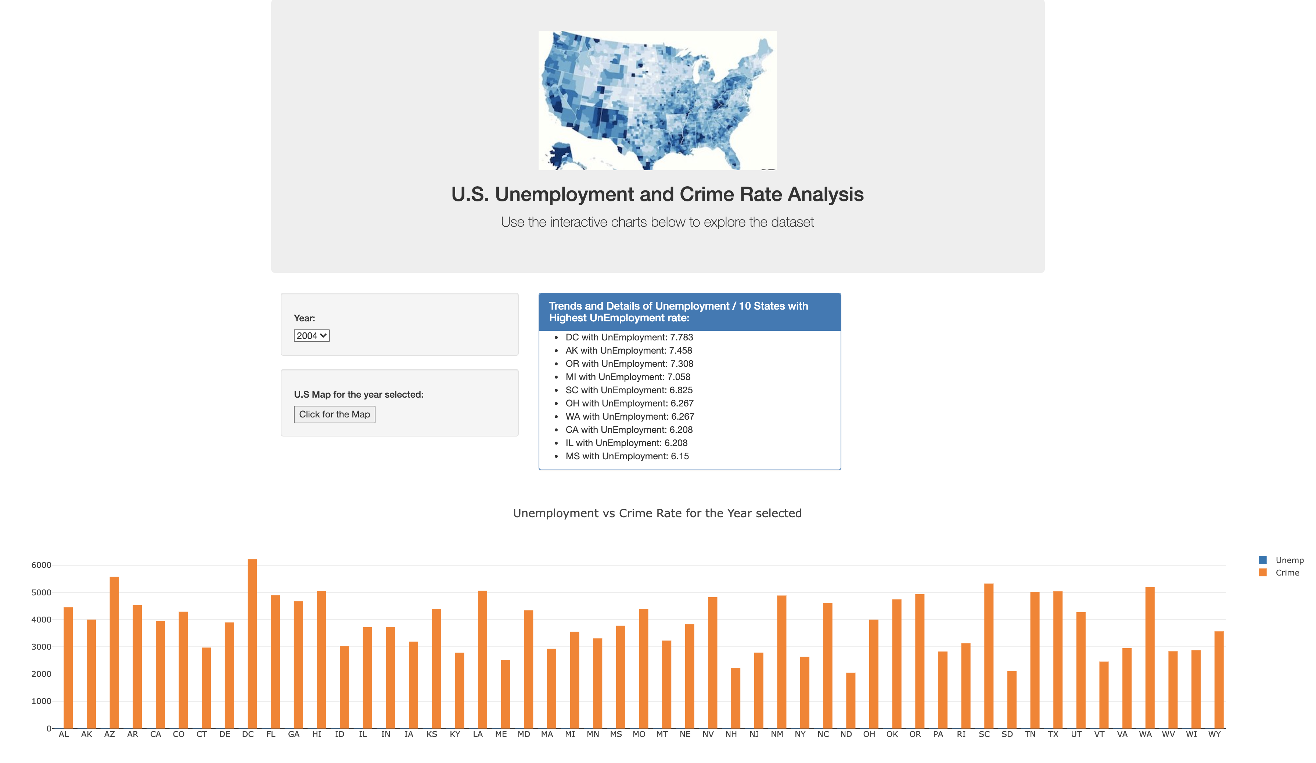
User interface

Slide 8
Dashboard Settings
User is capable to select the year of interest to evaluate both factor (i.e. Unemployment and Crime)
The user is also able to visualize a map which displays the profile of each state

Slide 9
Dashboard Settings
Based on the year selected by the user, data will be visualized as a bar chart showing the unemployment rate or crime rate of each state in the selected year. User can select between unemployment and crime rate to display the bar chart .

Slide 10
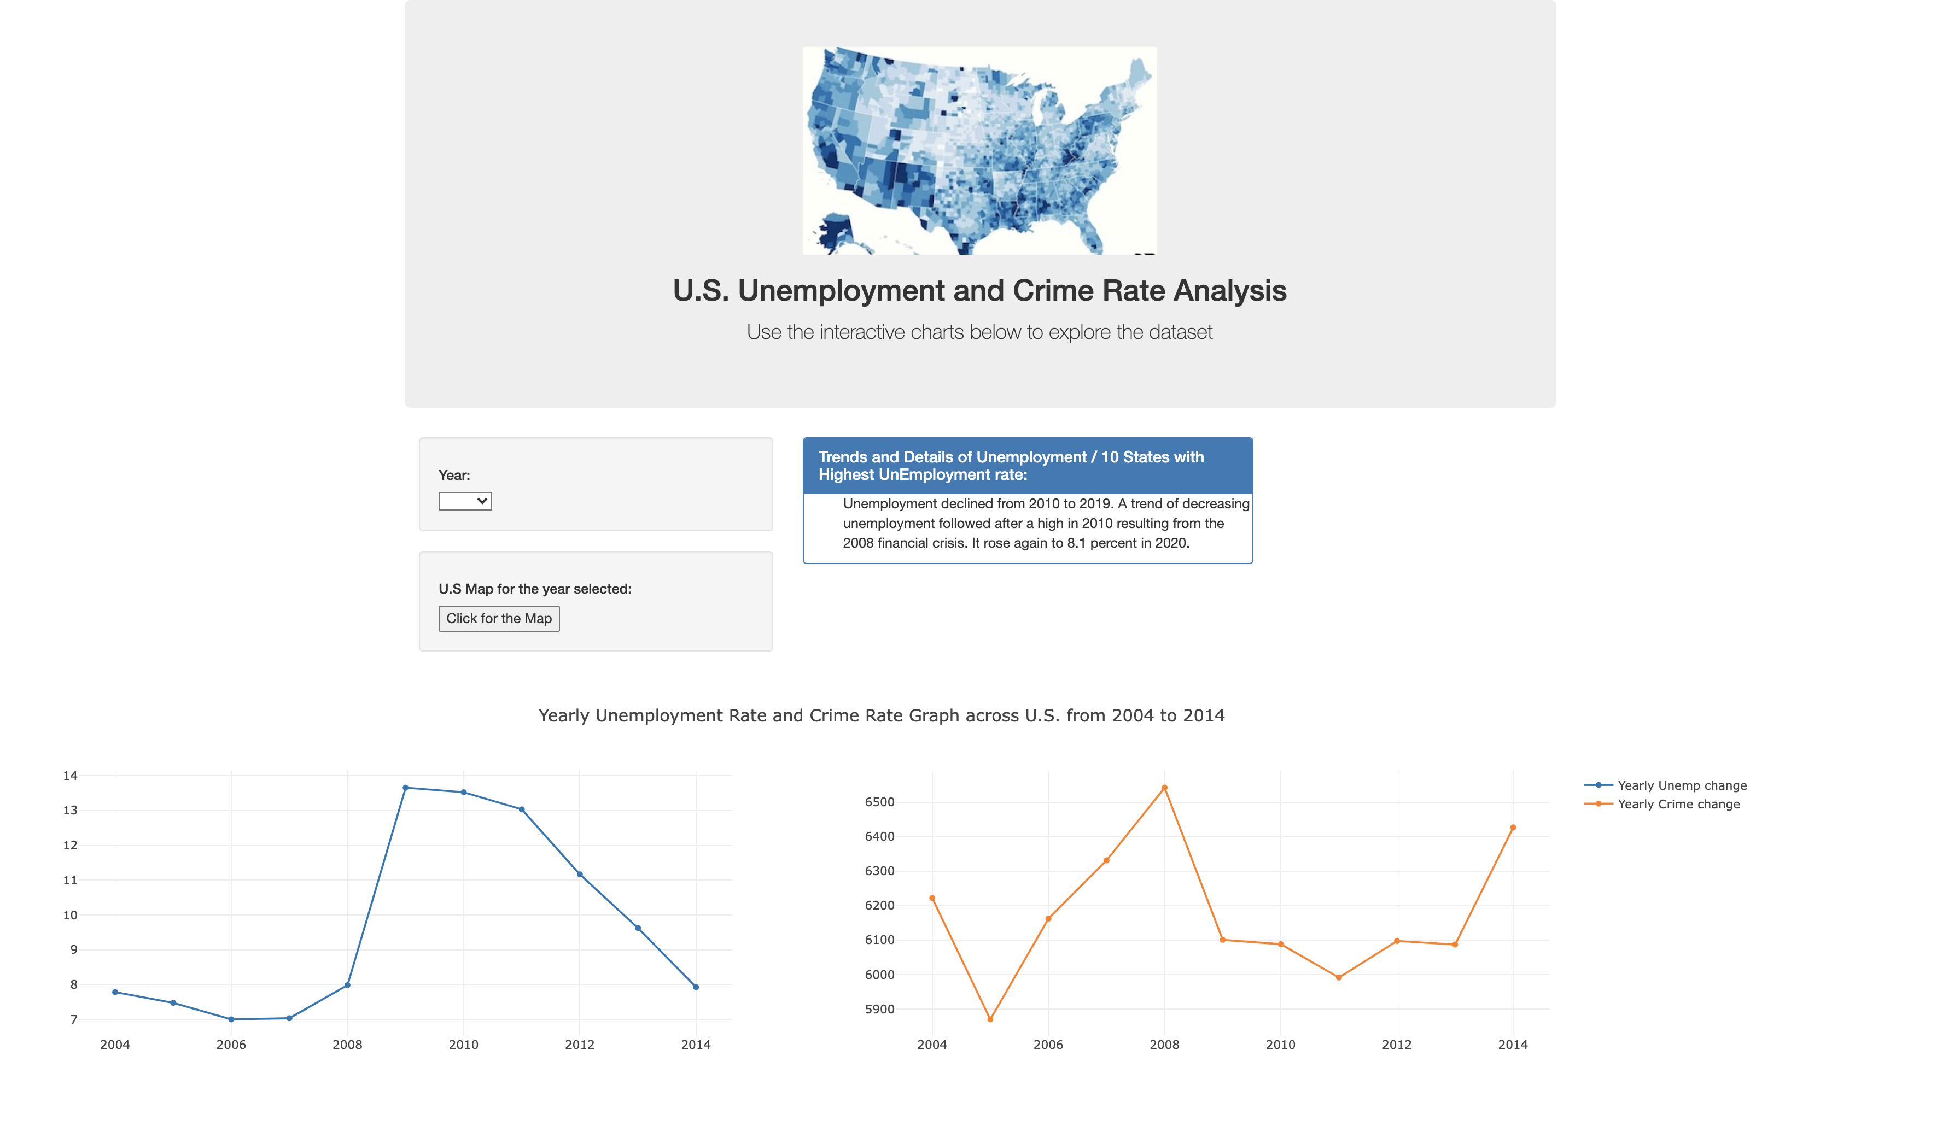
Additional tools in the dashboard

Slide 11
Digging deeper…
The dashboard has capabilities to show the user a detailed trend of the unemployment rate across the US
The timeframe set up to display ranges from 2004 to 2014.

Slide 12
Digging deeper…
Additionally, the dashboard has capabilities to show the user a detailed trend of the crime rate across the US from 2004 to 2014.
The information includes violent crimes and non-violent crimes.

Slide 13


Q&A
Q&A

Slide 14
Georgia Tech | Analytics Boot camp
Thank You
Team: 01 - 800 NEED CASH NOW | Project 3

